Slide 1
House sales dashboard project
File created on: 5/25/2024 6:05:15 AM

Slide 2
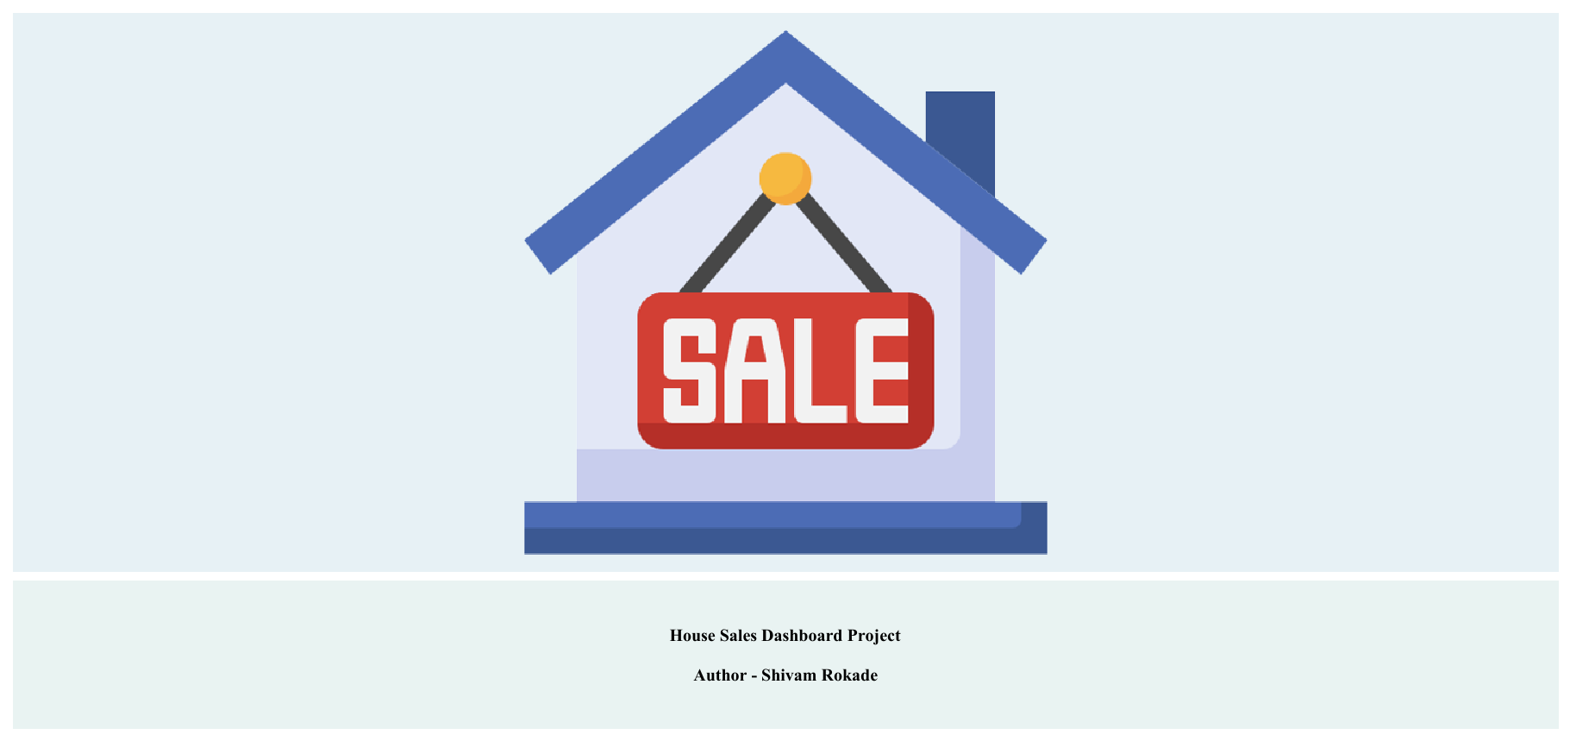

Slide 3
